Slide 1
TriMonkey
12.18.21
Group 2
Kat Allen, Ilan Felberg, David Gelfand, Alanna Levitt

Slide 2
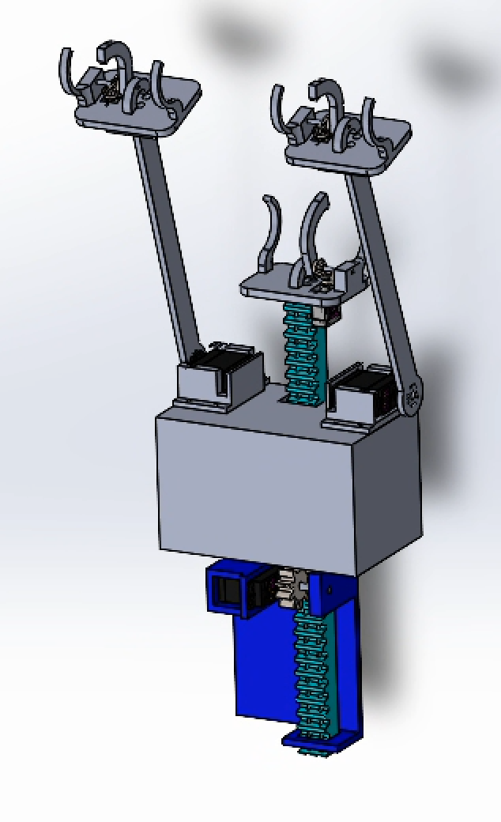
Recall: Design Review
David
Small Base
Base should be kept lightweight, but still able to house electronics and power supply using shelves
Adaptable Gripper allows us to grip different sized bars with a microservo
3 Arm System maintains stability in y direction and reduces torque on grippers
Adjustable Center Arm
Middle arm controlled by Rack and Pinion, maintains stability while two arms reach, and grip at different lengths
Creativity & Innovation

Slide 3
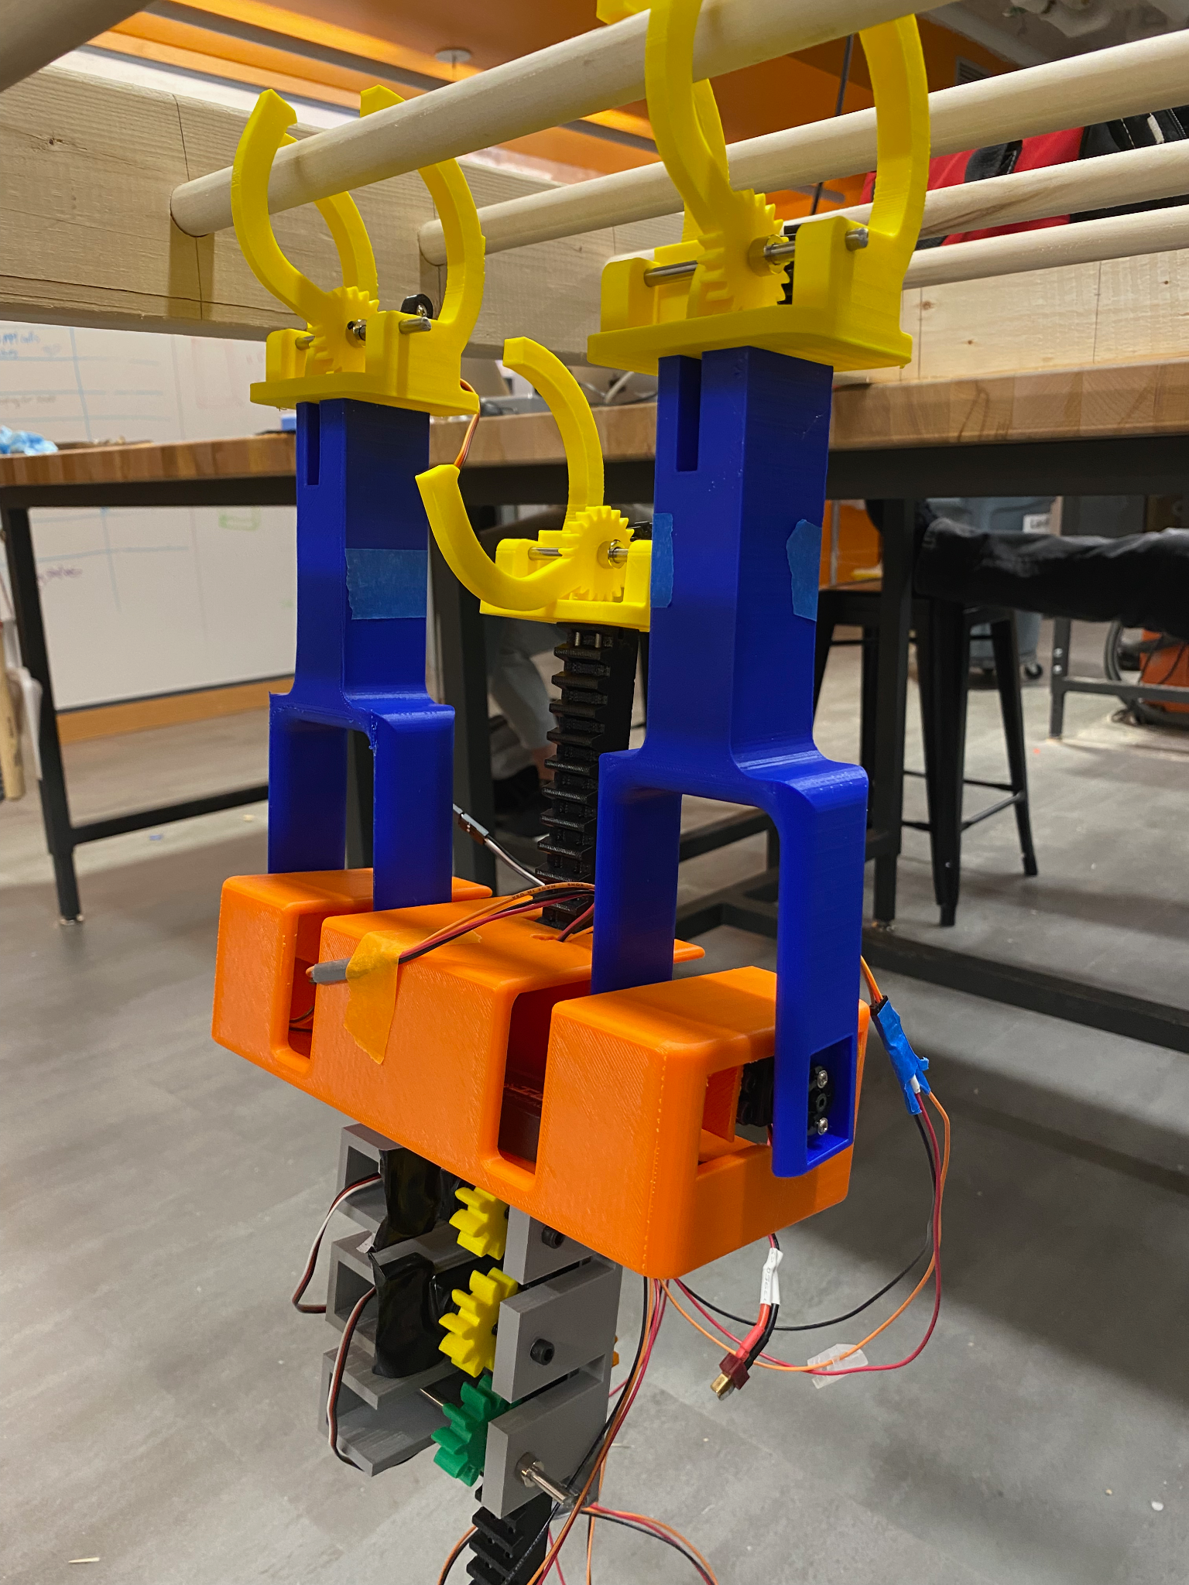
Lighter & Stronger
Ilan
Small Base
Stronger, smaller + encasement for z-rack to prevent cable capture.
Stronger Gripper
Spur gears improve grip strength, larger “fingers” are more resistant to breakage and can grab any bar
PiZero moved outside base for easier cable access during debugging
PiZero replaced with Pi4 due to rebooting/WiFi issue
Stronger Arms
Two-sided design attaches to a bearing on the passive side for additional stability
Adjustable Center Arm
Now using two continuous servomotors for additional strength + free gear for stability
Creativity & Innovation

Slide 4
Side Arms
Alanna
Paired Design
keeps robot from twisting off the bars
Two points of contact
Additional stability for each arm
Large Servomotors
Allow grippers to rotate into position at each bar

Slide 5
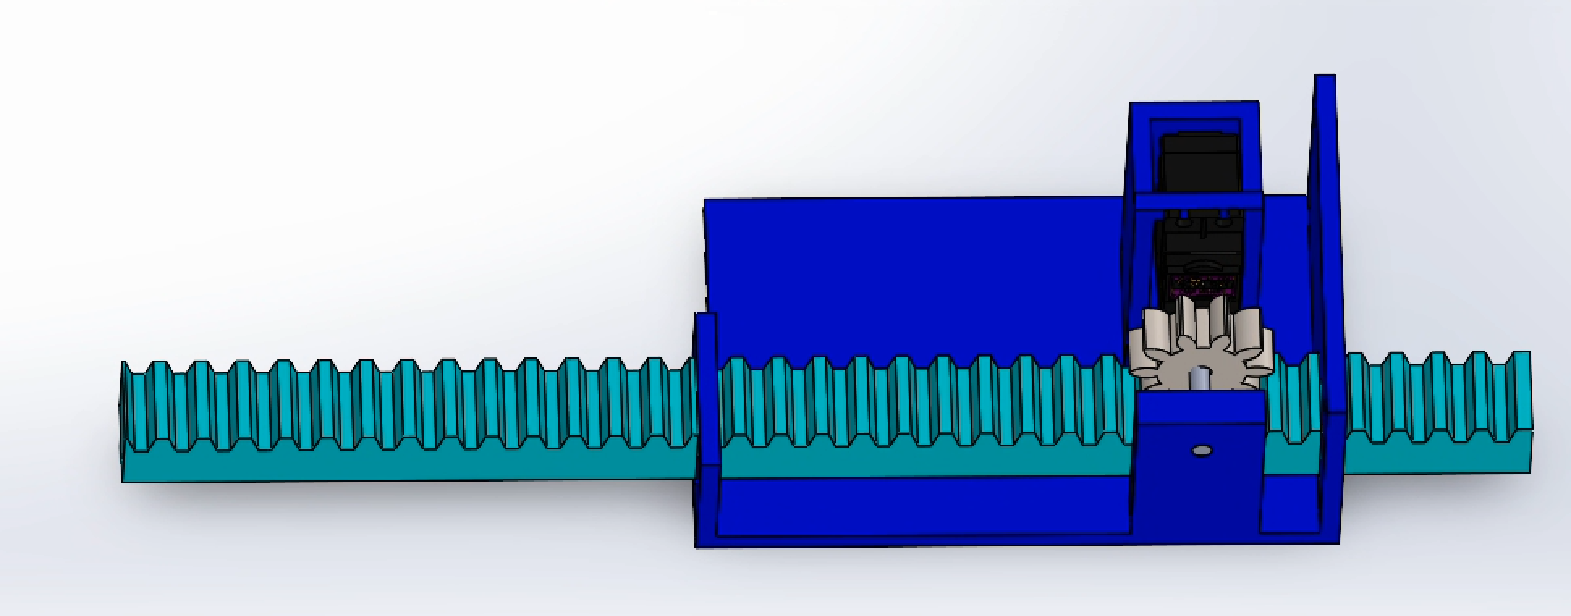
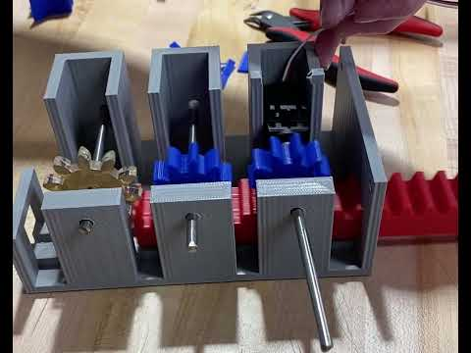
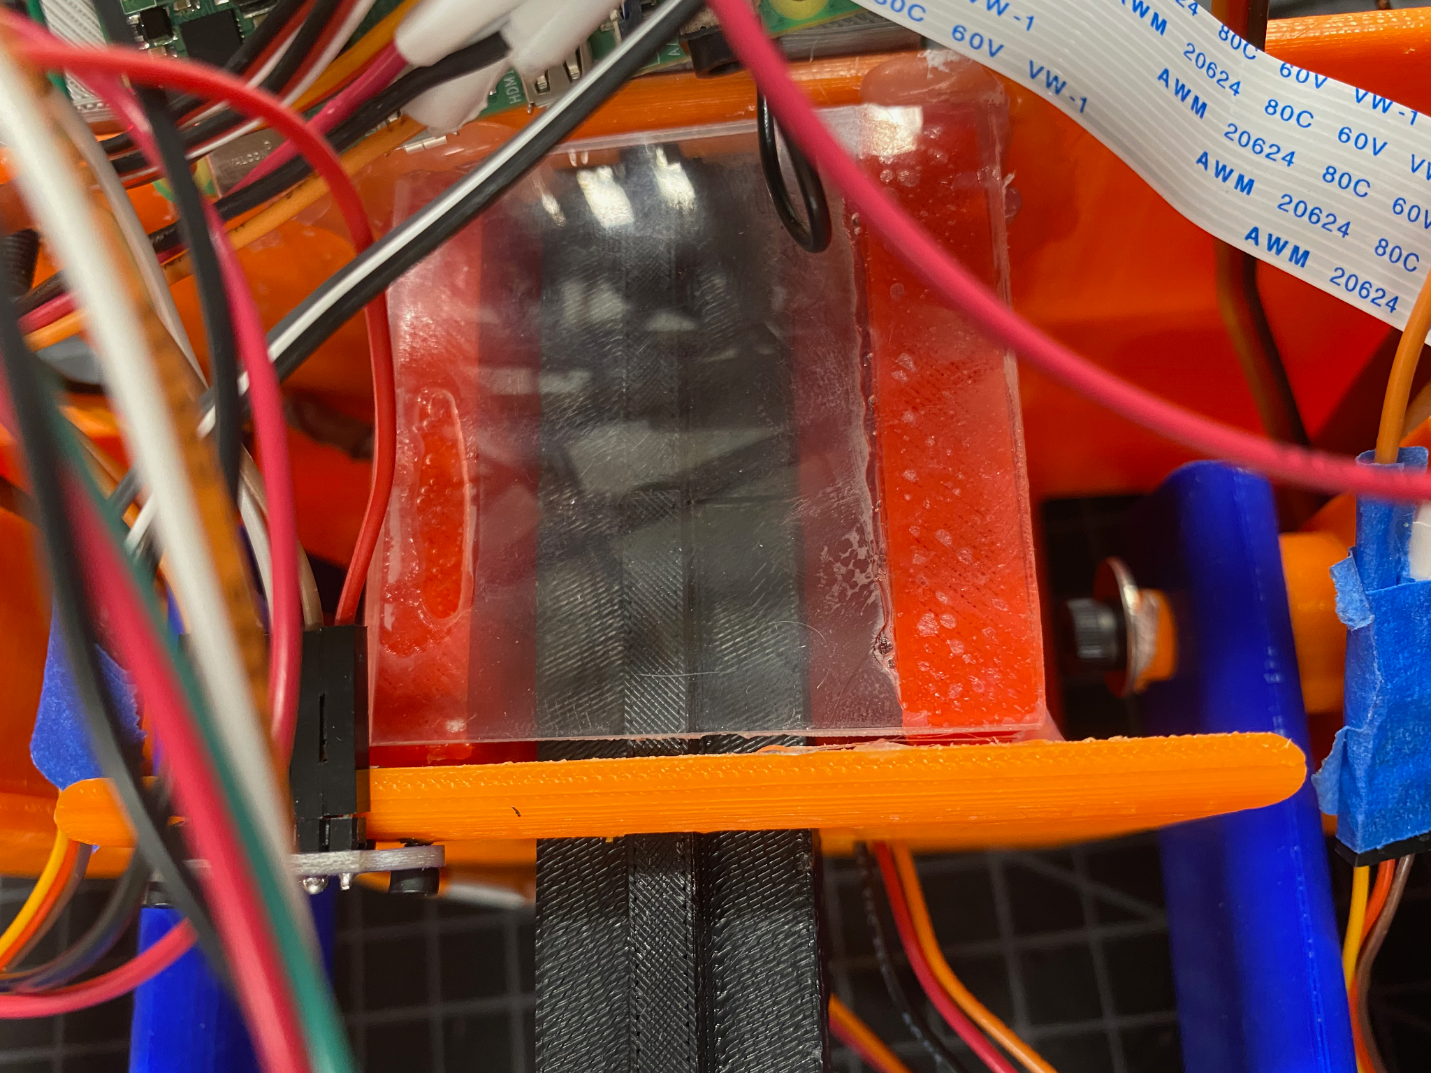
Center Arm
Before:
Kat
Rack and Pinion
Motor rotates to lengthen and shorten the arm
Support Bar
Prevents torque on the pinion gear
Keyed support window
Extended through entire center arm support
Fully encased in base section to protect cables
NEW:
Affordances for up to 3 continuous motors or supporting gears
Dovetail-joined rack 3D printed in pieces
Keyway along the entire arm base keep rack aligned

Slide 6
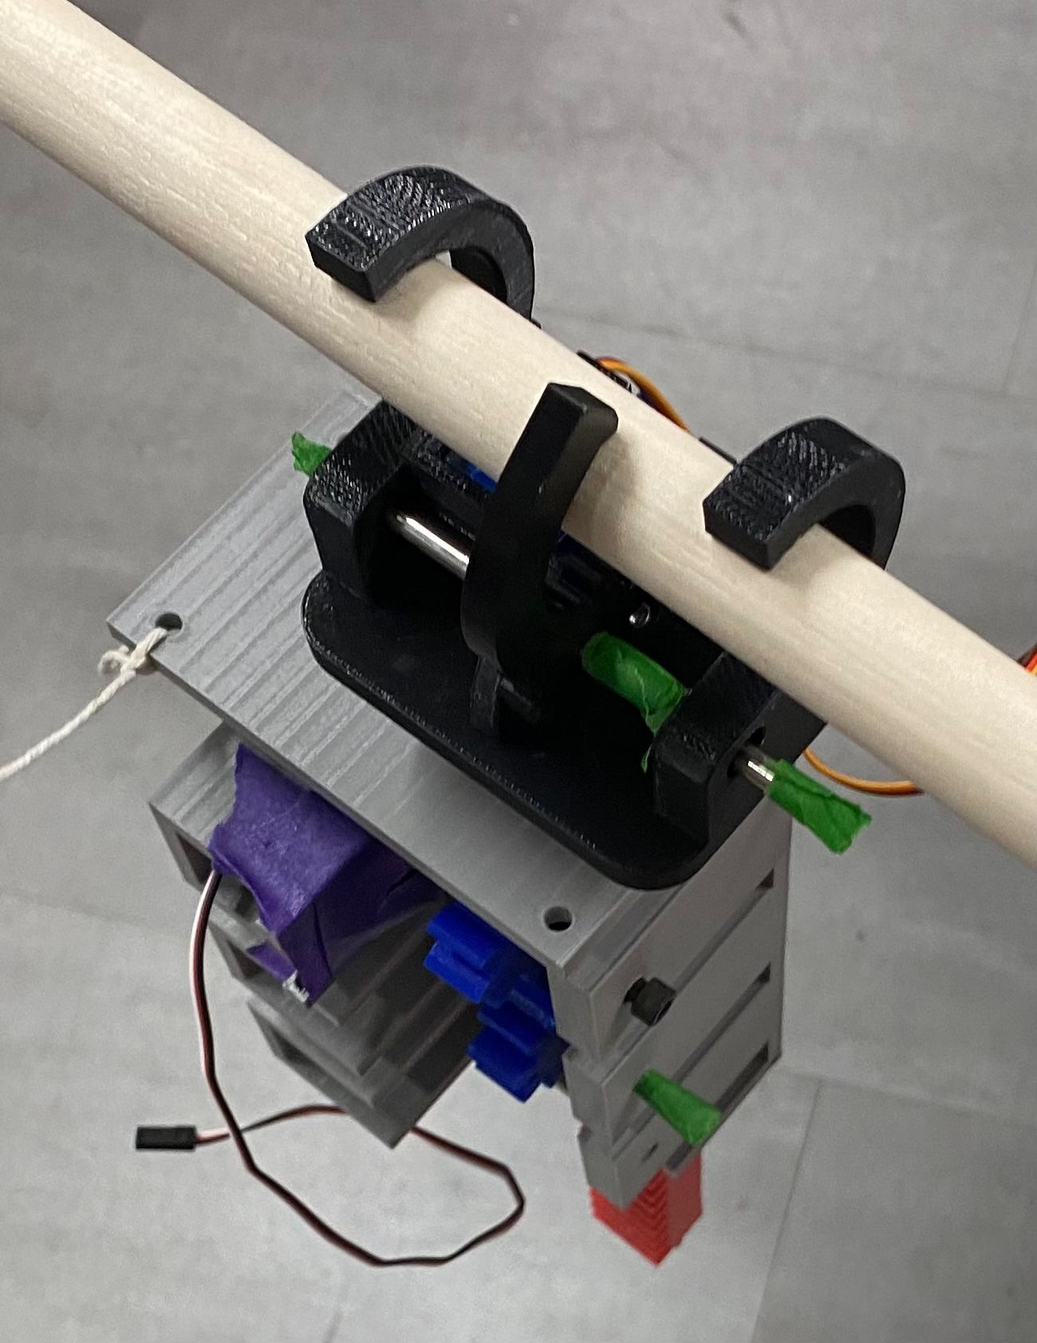
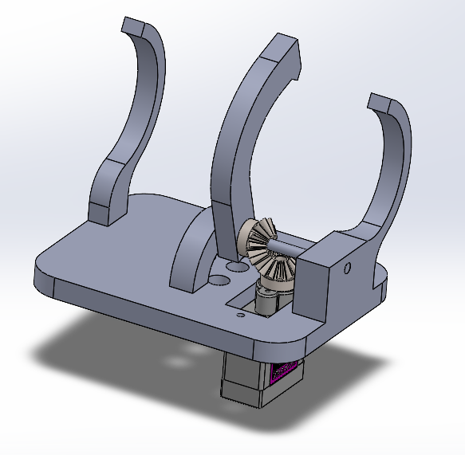
Gripping Mechanism
David
Miniature servomotors actuate the moving finger that grips the bar against the fixed fingers
Designed to accommodate both the large bar and small bars
Can hold robot with any one gripper

Slide 7
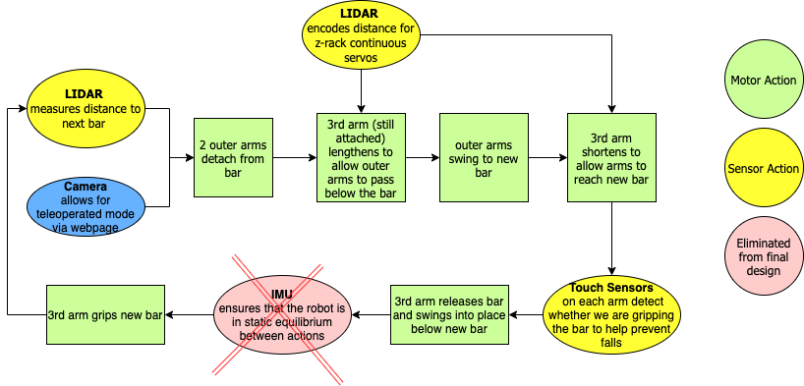
Electronics, Control, and Robot Motion Pattern
Kat

Slide 8
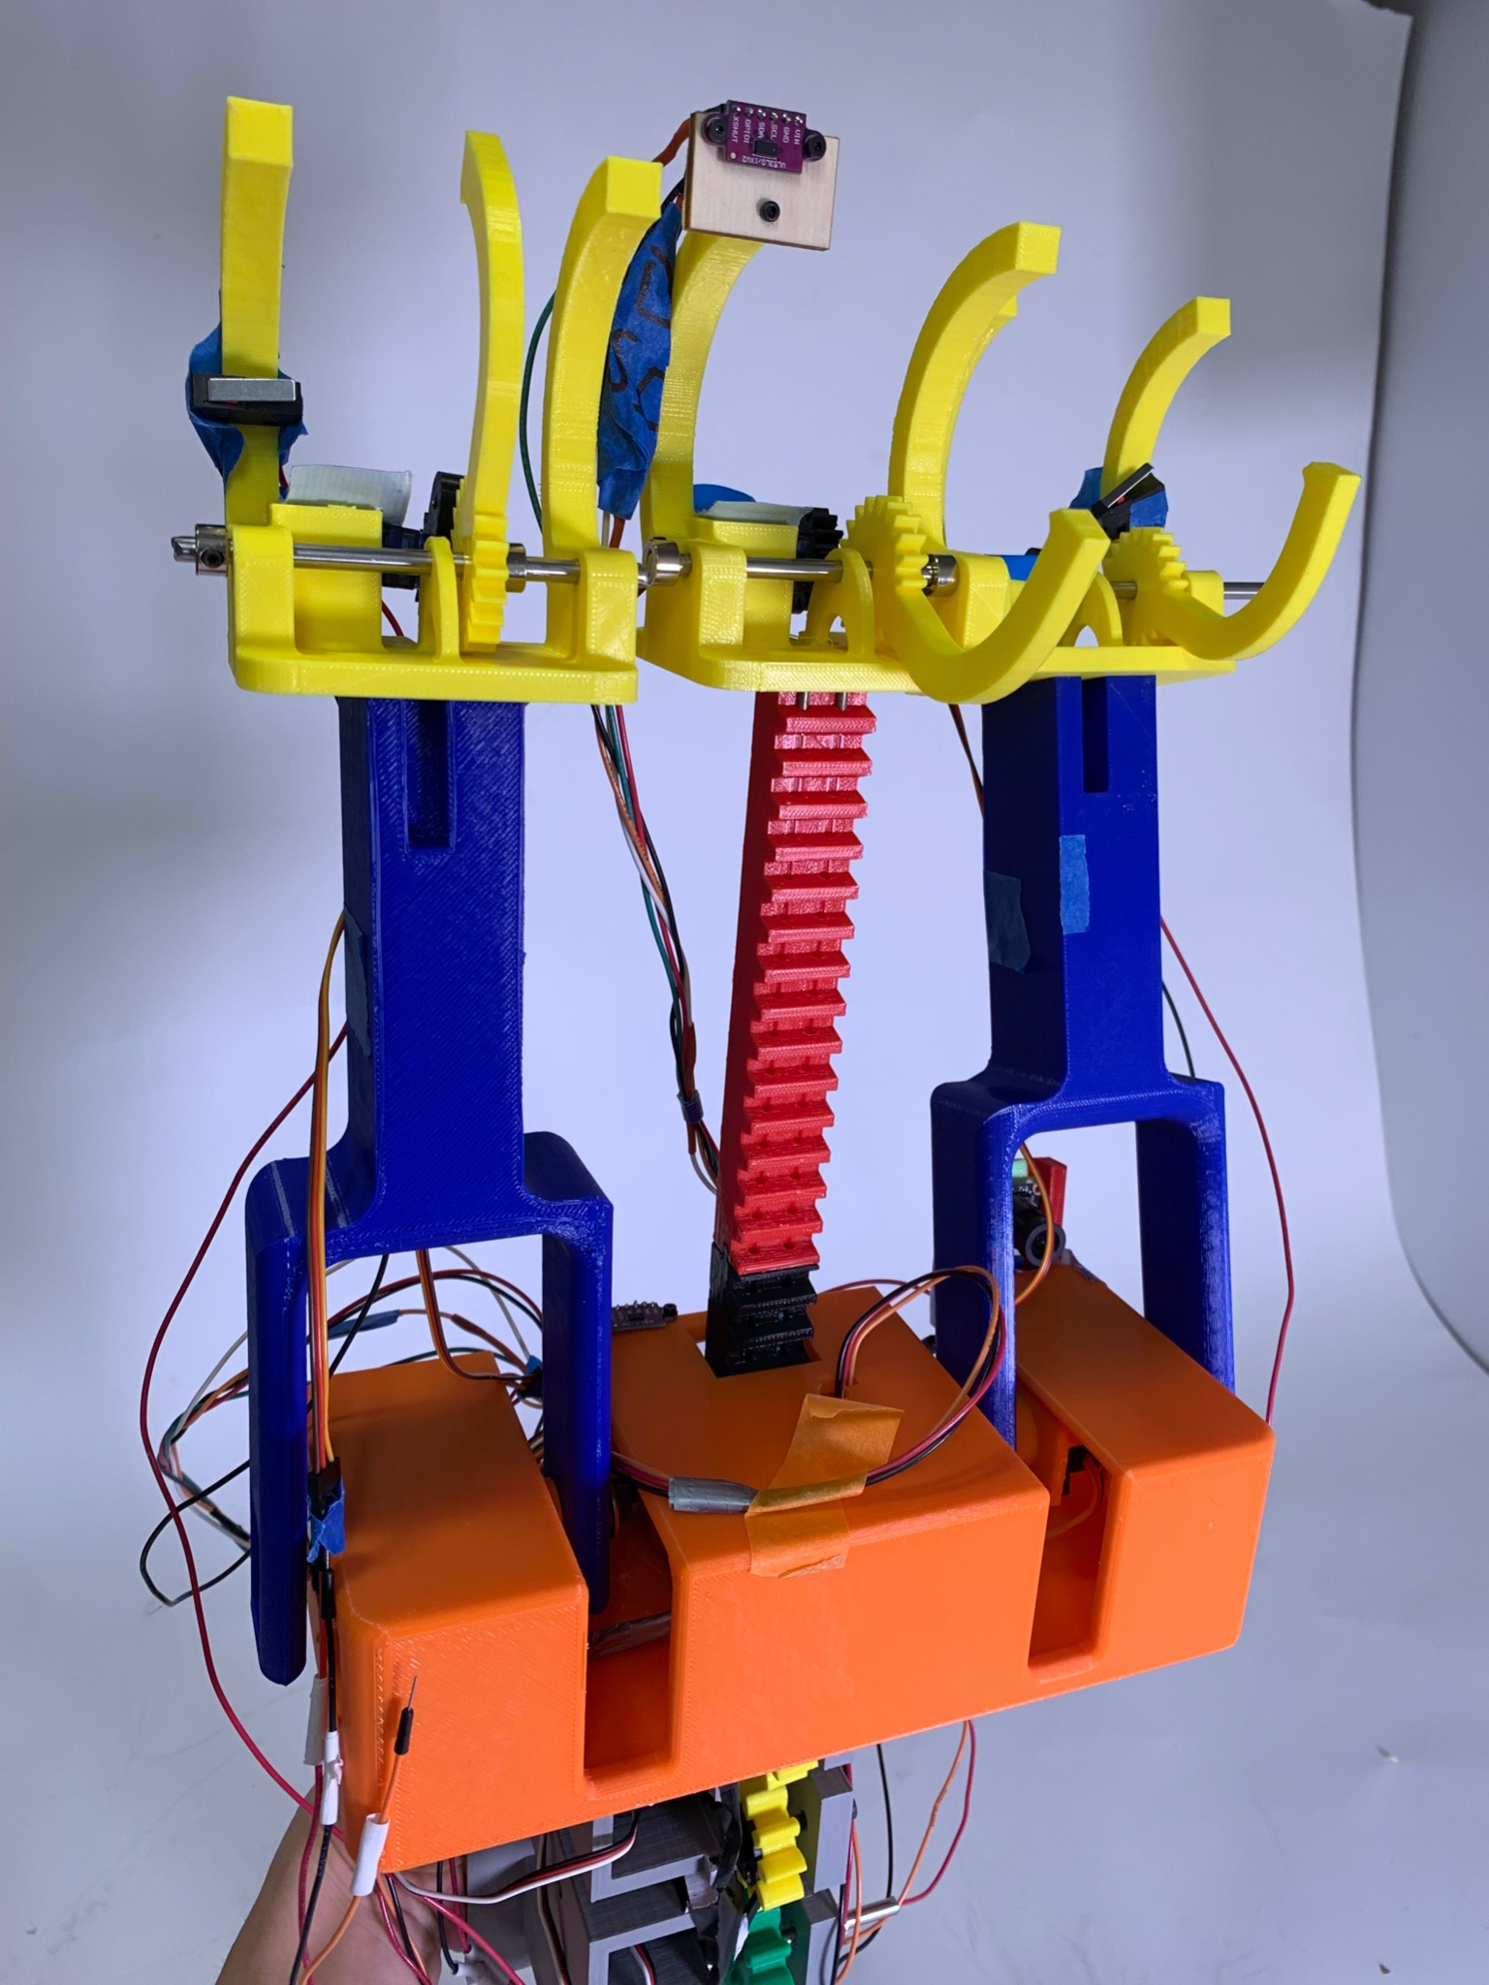
Sensors and Autonomous Control
Ilan
Touch sensor in each gripper to detect the bar and automatically close gripper
LIDAR on center arm to detect the distance to the next bar
Camera to control the robot in teleoperated mode and for a “monkey-eye view” display
LIDAR on base to detect vertical base displacement

Slide 9
Teleoperated Control
Alanna

Slide 10
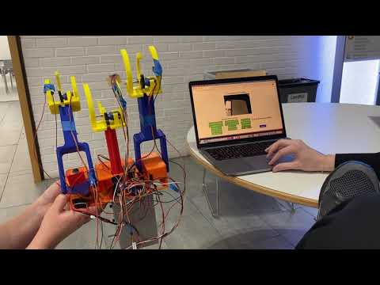
Teleoperated Control

Slide 11
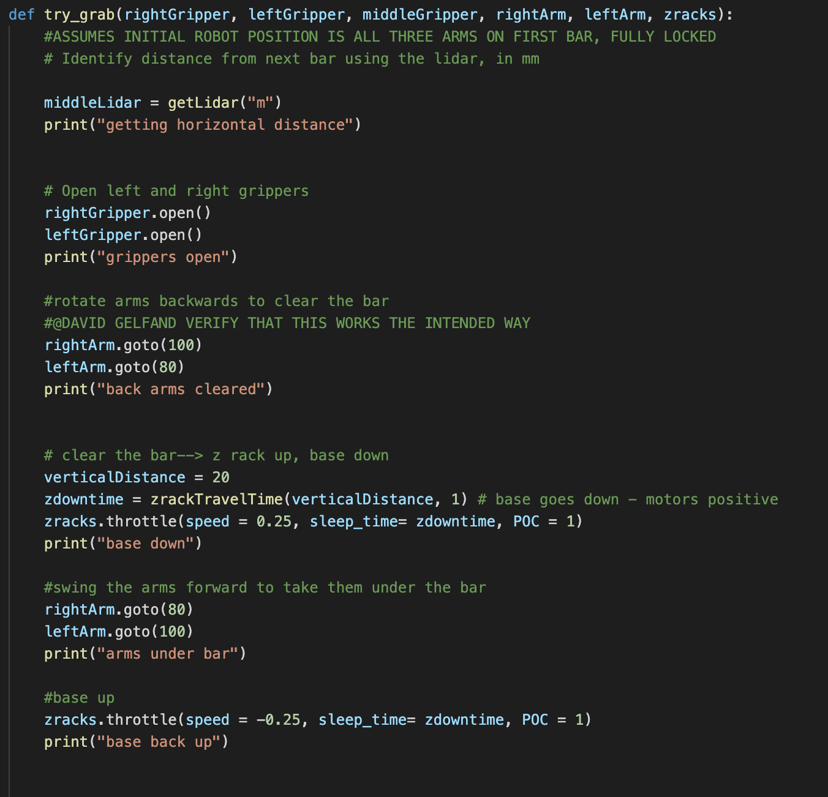
Autonomous Control
Ilan
Snapshot of process of autonomous bar movement
Real time mapping achieved with LIDAR instead of camera
Pictured:
lidar distances,
gripper actuation,
arm swinging,
LIDAR course mapping,
z-rack translation

Slide 12
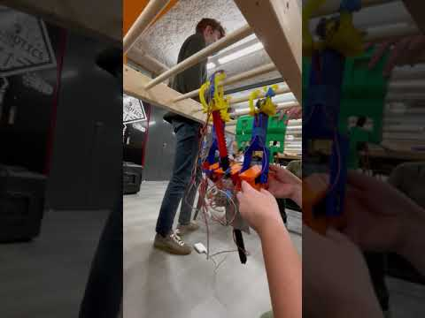
Video Demo
Kat
What’s Happening Here:
Outer arms disengage
Arms swing forward
Arms grab bar
(loose servo has to be reattached)
Arms swing “forward” tipping body back so z-arm can disengage
Z gripper opens
Arms swing “back” to bring the z-arm forward
Z arm raises up to bar level
Arms swing “back” more to align z-gripper to the bar
z -arm grabs the bar

Slide 13
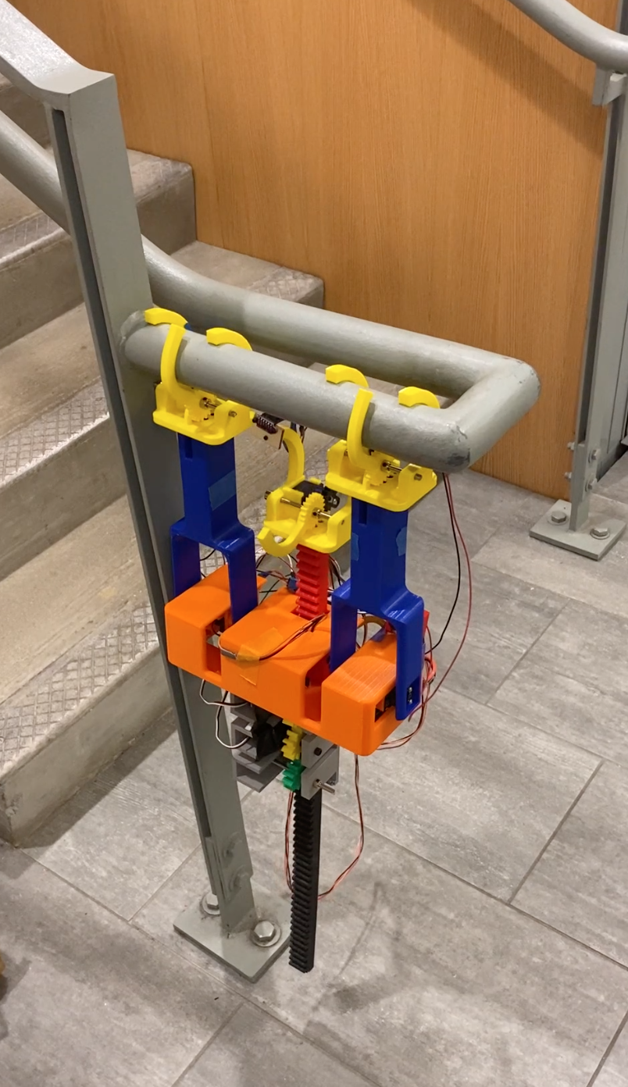
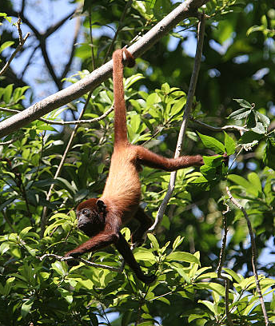
Thanks!
Questions?

